Slide 1
Exponentials & Logarithms
A2 Review Questions

Slide 2
Question 1
$$\log_{2}128$$

Slide 3
Answer 1
7

Slide 4

Question 2
$$\log_{5}\frac{1}{125 }$$

Slide 5
Answer 2
-3

Slide 6

Question 3
$$\log_{49}\frac{1}{7}$$

Slide 7
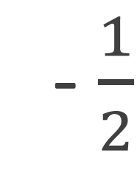
Answer 3
- $\frac{1}{2}$

Slide 8
Question 4
$$ln⁡(1)$$

Slide 9
Answer 4
0

Slide 10
Question 5
To the nearest whole number:

Slide 11
Answer 5
145

Slide 12
Question 6
To the nearest whole number:

Slide 13
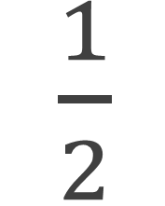
Answer 6
$\frac{1}{2}$

Slide 14
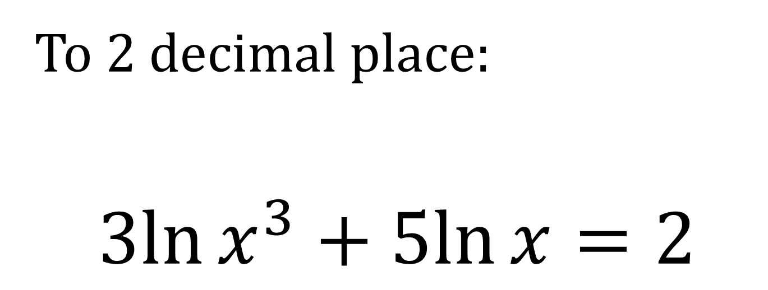
To 2 decimal place:
$$3ln{x^{3}}+5ln{x}=2$$
Question 7

Slide 15
Answer 7
1.15

Slide 16
The boredness $B$ over time $t$ (Minutes) during a maths lesson can be modelled by:
$$B=\frac{1}{2}e^{0.03t}$$
How bored are you at the start of the lesson?
Question 8

Slide 17
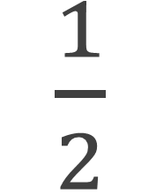
Answer 8
$\frac{1}{2}$

Slide 18
The boredness $B$ over time $t$ (Minutes) during a maths lesson can be modelled by:
$$B=\frac{1}{2}e^{0.03t}$$
If a lesson is an hour long. How bored will you be after 0.4 lessons? Give your answer to 2 decimal places.
Question 9

Slide 19
Answer 9
1.03

Slide 20
The boredness $B$ over time $t$ (Minutes) during a maths lesson can be modelled by:
$$B=\frac{1}{2}e^{0.03t}$$
After how many minutes (to the nearest minute) of maths will you be have a boredness of 3?
Question 10

Slide 21
Answer 10
60 minutes
or
1 hour

Slide 22
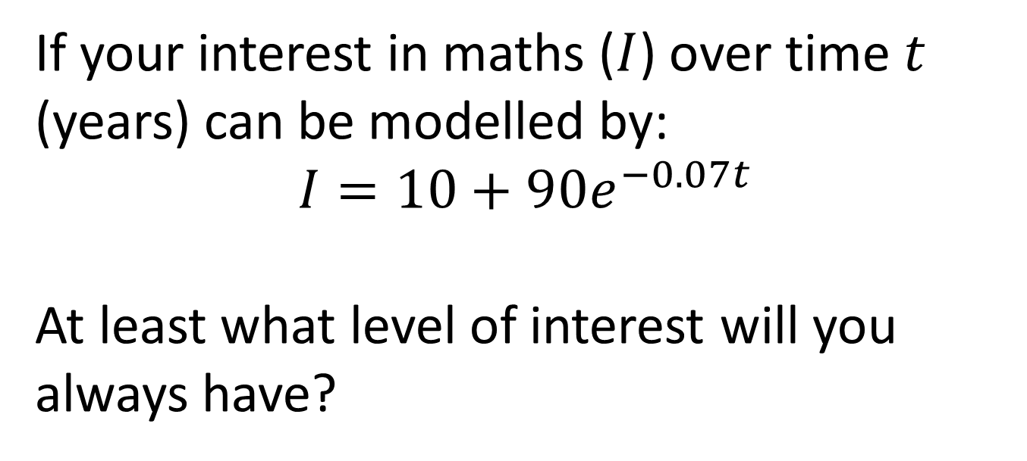
If your interest in maths ($I$) over time $t$ (years) can be modelled by:
$$I=10+90e^{−0.07t}$$
At least what level of interest will you always have?
Question 11

Slide 23
Answer 11
Think – what happens as e^{x} tends towards infinity?
10

Slide 24
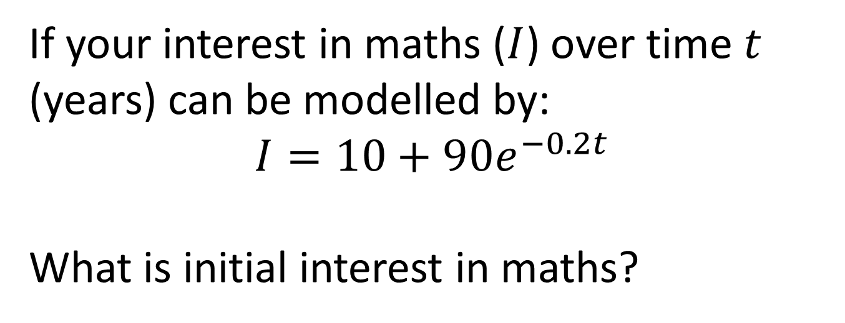
If your interest in maths ($I$) over time $t$ (years) can be modelled by:
$$I=10+90e^{−0.2t}$$
What is initial interest in maths?
Question 12

Slide 25
Answer 12
100

Slide 26
If your interest in maths ($I$) over time $t$ (years) can be modelled by:
$$I=10+90e^{−0.2t}$$
If today is 25th June 2015, what interest will you have on Christmas Day 2015?
Give your answer to 1 decimal place.
Question 13

Slide 27
Answer 13
Think – don’t stress the number of days in months
91.4

Slide 28
If your interest in maths ($I$) over time $t$ (years) can be modelled by:
$$I=10+90e^{−0.2t}$$
After how many years will your interest in maths have quartered? Give your answer to 1 decimal place
Question 14

Slide 29
Answer 14
9.0

