Slide 1
Edexcel Formulae
You need to know this for your GCSE
(Higher tier only formulae are indicated)

Slide 2
Rectangle = l × w
w
l
AREA

Slide 3
Parallelogram = b × h
h
a
b
AREA

Slide 4
Triangle = $\frac{1}{2}$ b × h
h
b
AREA

Slide 5
Trapezium = $\frac{1}{2}$ (a+b) × h
a
h
b
AREA

Slide 6
Circumference = π × diameter
C = πd
Diameter
Circles

Slide 7
Circumference = 2 × π × radius
C = 2πr
Centre
Radius
Circles

Slide 8
Area = π × radius × radius
A = πr²
Centre
Radius
Circles

Slide 9
Cuboid = $l$× w × h
h
w
$$l$$
VOLUME

Slide 10
Prism = $area of cross section$× length
Area
of cross section
$$l$$
VOLUME

Slide 11
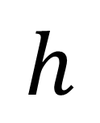
Cylinder = area of circle × height
Cylinder = πr²h
r
$$h$$
VOLUME

Slide 12

Pyramid = $\frac{1}{3 }$ area of base × height
$$h$$
VOLUME
Higher tier only

Slide 13
Speed = Distance ÷ Time
The clue is in the units
eg speed in m/s, indicates metres ÷ seconds
COMPOUND MEASURES

Slide 14
Density = Mass ÷ Volume
The clue is in the units
eg density in g/cm³,
indicates weight in grams ÷ volume in cm³
COMPOUND MEASURES

Slide 15
Pressure = Force ÷ Area
The clue is in the units
eg speed in N/m²,
indicates force in Newtons ÷ area in m²
COMPOUND MEASURES

Slide 16
Pythagoras
h
a² + b² = h²
b
a
(h is always the hypotenuse)
RIGHT-ANGLED TRIANGLES

Slide 17
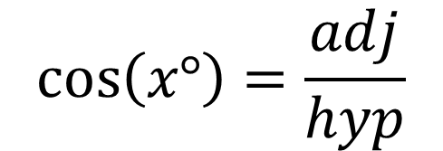
Trigonometry
hyp
$$\sin\left(x°\right)=\frac{opp}{hyp}$$
opp
x⁰
$$\cos\left(x°\right)=\frac{adj}{hyp}$$
adj
Check your calculator is in degrees
$$\tan\left(x°\right)=\frac{opp}{adj}$$
RIGHT-ANGLED TRIANGLES

Slide 18
Sine Rule
C
Higher tier only
b
a
A
B
c
$$\frac{a}{sin⁡(A)}=\frac{b}{sin⁡(B)}=\frac{c}{sin⁡(C)}$$
Check your calculator is in degrees
NON-RIGHT-ANGLED TRIANGLES

Slide 19
Cosine Rule
C
Higher tier only
b
a
A
B
c
Check your calculator is in degrees
$$a^{2}=b^{2}+c^{2}−2bc×cos(A)$$
NON-RIGHT-ANGLED TRIANGLES

Slide 20
Area of a triangle
C
Higher tier only
b
a
A
B
c
Check your calculator is in degrees
Area = $\frac{1}{2}a×b×sin(C)$
NON-RIGHT-ANGLED TRIANGLES

Slide 21
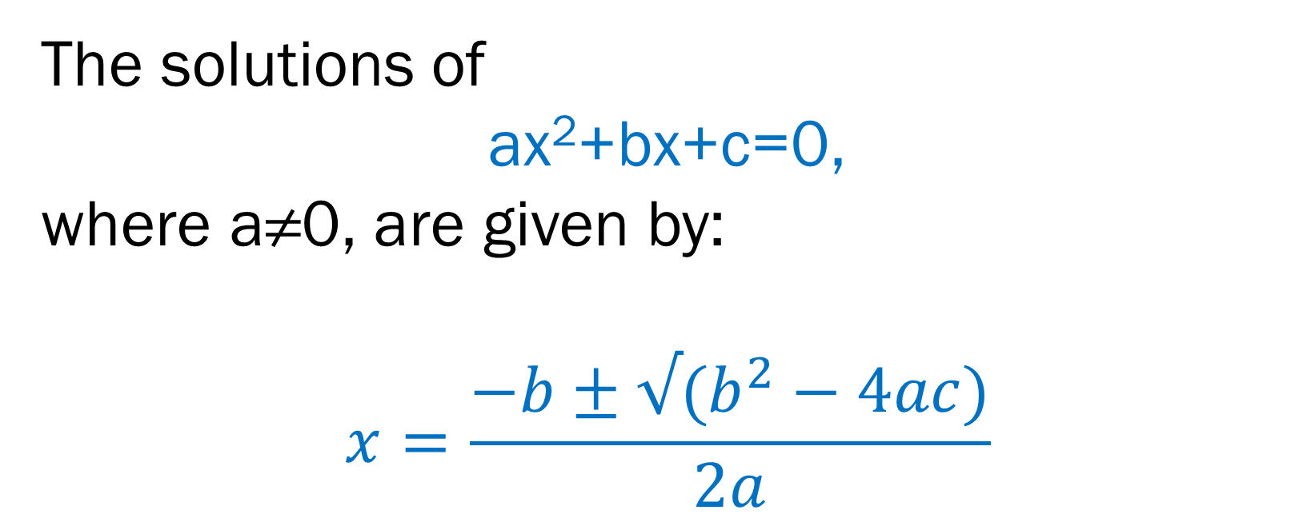
Quadratic Equations
Higher tier only
The solutions of
ax²+bx+c=0,
where a≠0, are given by:
$$x=\frac{−b±√(b^{2}−4ac)}{2a}$$
Algebra

