Slide 1
“I can’t believe I did that!”
Common mistakes from the 2022 summer exams.
Don’t let this be you!

Slide 2
1. Made a mistake with negative numbers
Use a mental method to check the sign in your working, especially if you’ve expanded a bracket or you’ve typed it into a calculator

Slide 3
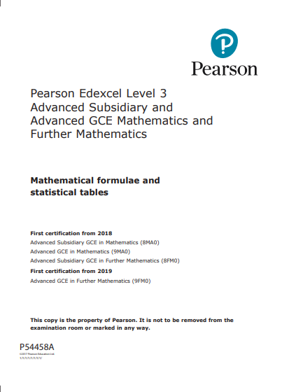
2. Forgot to use the formula book
It takes a few seconds to double check a rule, why chance it?

Slide 4
3. Didn’t show full working out
There is a reason your teachers nag you – on A-level questions just getting the correct answer isn’t enough for full marks.

Slide 5
4. Didn’t actually answer the question
If a question asks for a context, give the context.
Eg if a model means that an answer of 54 means 54000, give the answer 54000 not 54

Slide 6
5. Dodgy rounding
If a question specifies 3 significant figures, it wants 3 significant figures.
Anything else won’t get full marks.

Slide 7
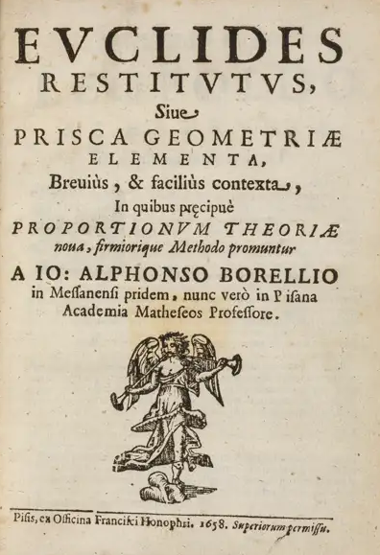
6. Skipped revising standard proofs
When you make notes in lesson and the teacher says this could come up in the exam, what the teacher means is THIS COULD COME UP IN THE EXAM SO YOU’D BETTER REMEMBER TO REVISE IT.

Slide 8
7. Attention to detail
What is the model you are using? Do you have to answer in context? Do you have to relate your result to another figure or compare it?

Slide 9
8. One word answer for a one mark question
If the question asks you to find a number (or binary response) and give a reason, you won’t get the mark if you don’t give the reason.

Slide 10
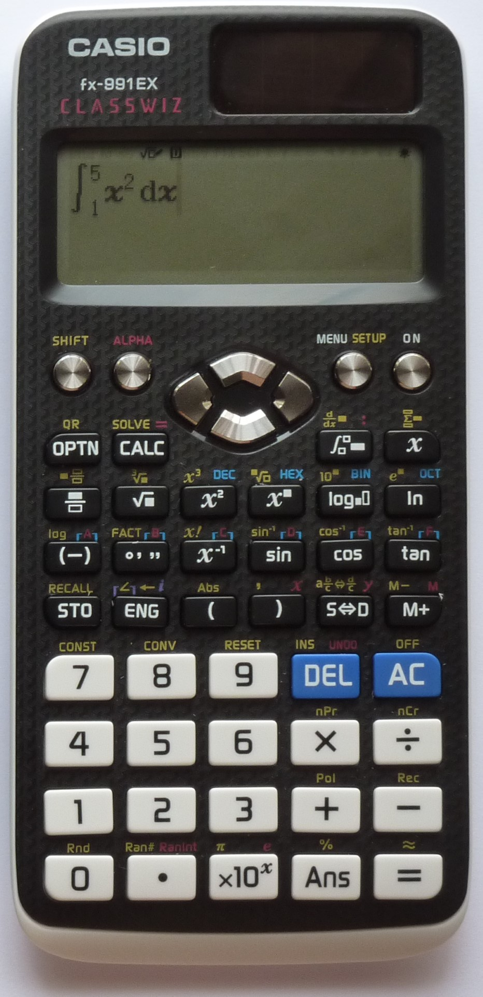
9. Put the algebra question in the calculator
If a question asks for algebra, use algebra.
It may not specify that you can’t use a calculator, but use your common sense. By all means check with a calculator.

Slide 11
10. Used constant acceleration formulae for a variable acceleration question
If there is any mention of a function of time in the distance, velocity or acceleration check for variable acceleration.

Slide 12
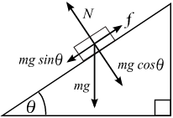
11. Rushed the force diagram
It doesn’t need to be a work of art, but a force diagram should be big enough to read/use. Remember that in many cases there are opposite forces, so check you have them (especially the normal reaction)

Slide 13
12. Baffled by problem solving with sequences
a₁ = cos(x), a₂ = 0.5sin(2x), a₃ = cos(x) – cos²(x), …
Go back to basics
What is the general form of the First term? Second term?...
Use these with the given sequence to form equations you could solve.

Slide 14
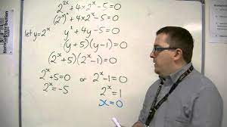
13. Didn’t spot the hidden quadratic
Lovely example on YouTube by TLMaths
If you have three terms and they look similar, could they be manipulated into a quadratic? It’s okay to multiply through by a common factor, if that helps.
Substituting for a letter might also make it easier to get started

Slide 15
14. Didn’t spend enough time on the graph sketch
Another one you will have been nagged about:
Axes with a ruler
Points of intersection
Asymptotes clearly used & indicated

Slide 16
15. Splatter working out
You’ve done a page of working out, but what does it mean?
Leaving a line between subsections makes it easier to read
Labelling subsections of the question helps the examiner track ideas
Say what you are doing – don’t go overboard, just an indicator if it’s a complicated process (eg a proof)

Slide 17
16. Large Data set blank
Although the LDS is covered in Y12, it’s also referred to in Y13 and will come up in exam questions.
Don’t assume that it will come back you, revise it.

Slide 18
Based on the Edexcel A-Level Maths exams 2022

